Slide 1




A Feed Forward Neural Network - Powered Chatbot for College Website
Under the Supervision of
Presented by Batch-13
DR. A. S. N. Chakravarthy Professor Department of CSE UCEK (A) JNTU KAKINADA
21025A0571 - Bhogadi Vidhey 20021A0532 -Thondupu Leela Anitha 20021A0517 - Telugu Saisri 20021A0565 - Ghanta Harshith

Slide 2

Contents
Introduction
1
2
Architecture
Modules Used
3
4
Implementation
Results
5
6
References

Slide 3
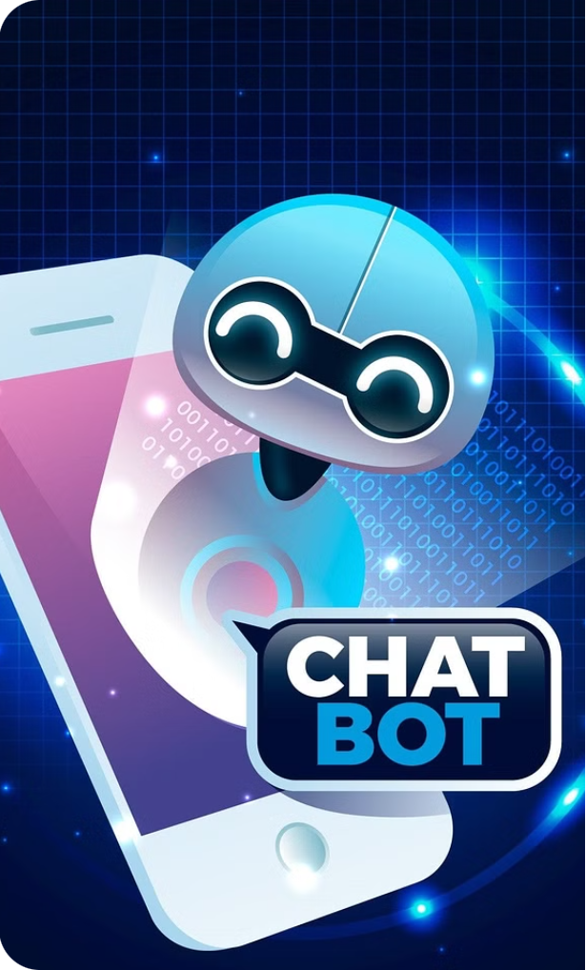
Introduction
Chatbots can answer common student queries using AI and natural language processing instead of a human representative, improving efficiency.
The college inquiry chatbot allows students to ask questions in native language and quickly get requested info without visiting colleges.
It has an updatable database with essential college data to provide accurate responses about changing curriculum, schedules etc.
The bot reduces paperwork, manpower and the need for students to personally visit colleges for routine information.
The chatbot system aims to save time for students, parents and college faculty by automating responses to common inquiries.

Slide 4

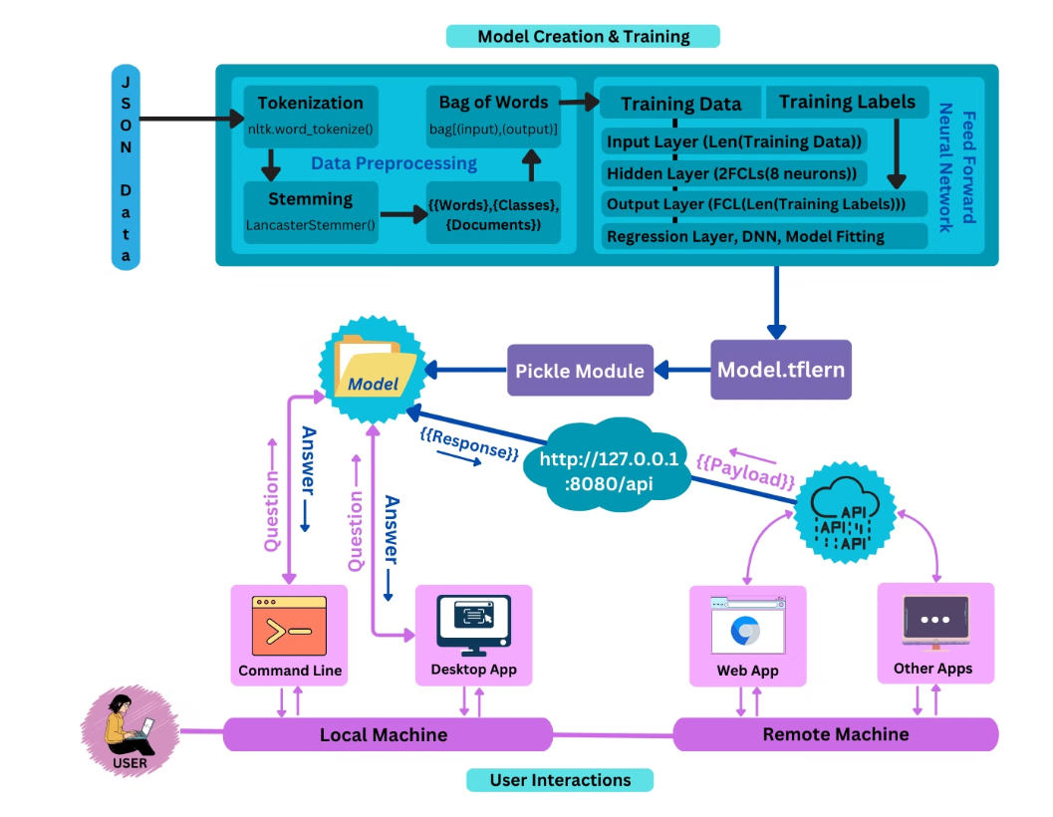
Architecture of Proposed System

Slide 5
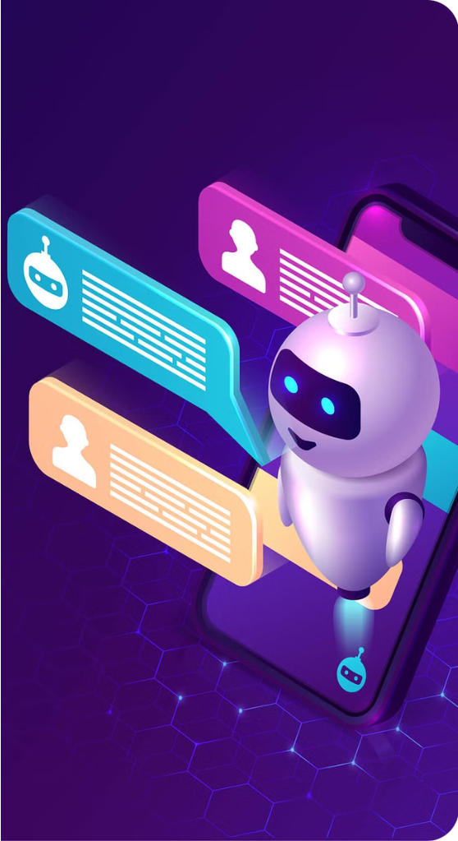
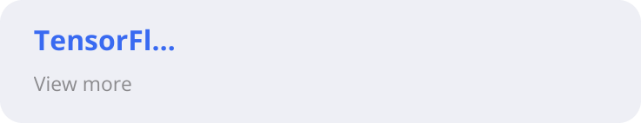
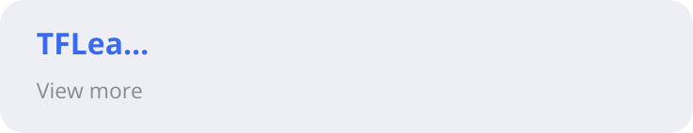
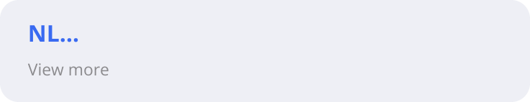
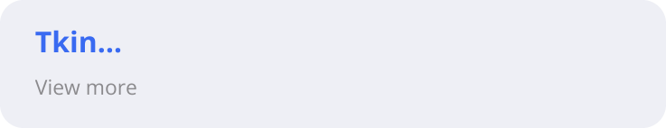
Modules Used In Proposed System

Slide 6
TensorFlow
Powerful library for training deep learning models.
TensorFlow is an open-source deep learning framework developed by Google for building, training, and deploying machine learning models.
It is designed to provide a flexible and efficient platform for developing a wide range of deep learning algorithms and applications.

Slide 7
TFLearn
Provides a high-level API for the TensorFlow library.
TFLearn (TensorFlow Learn) is a high-level deep learning library built on top of TensorFlow. It provides an easy-to-use interface for building, training, and evaluating deep learning models.
TFLearn simplifies the process of creating neural networks by abstracting away many of the low-level details, allowing developers to focus on model design and experimentation.

Slide 8
NLTK
NLTK is a natural language processing library.
Tokenization: Tokenization is the process of breaking text into smaller units, such as words or sentences, called tokens, which can then be analyzed individually.
Stemming: Stemming is the process of reducing words to their root or base form, by removing affixes such as suffixes or prefixes, to simplify analysis or improve matching during information retrieval.
Bag of Words: Bag of Words is a method used in natural language processing (NLP) where a text document is represented as an unordered collection or "bag" of words, disregarding grammar and word order but keeping track of their frequency of occurrence.

Slide 9
Tkinter
Tkinter is a Graphical User Interface toolkit for Python.
Tkinter is a built-in Python library used to create graphical user interfaces (GUIs) for desktop applications. It provides a set of tools and widgets (GUI components) that allow developers to design and implement interactive applications with graphical elements such as buttons, labels, textboxes, checkboxes, and more.

Slide 10

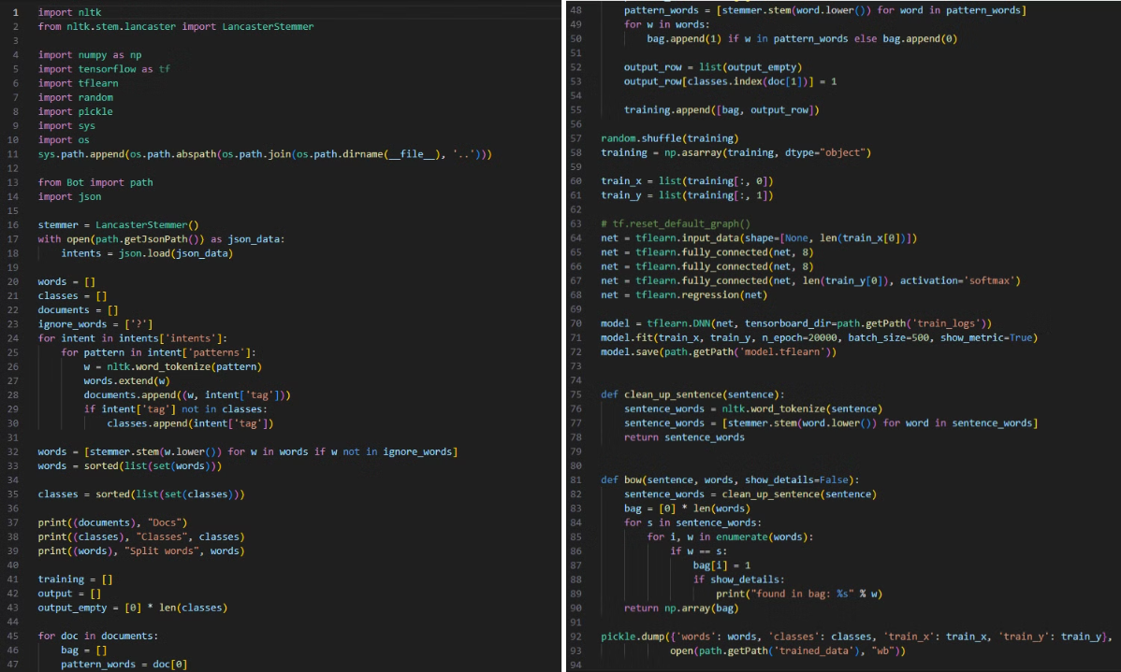
Implementation
Train.py

Slide 11

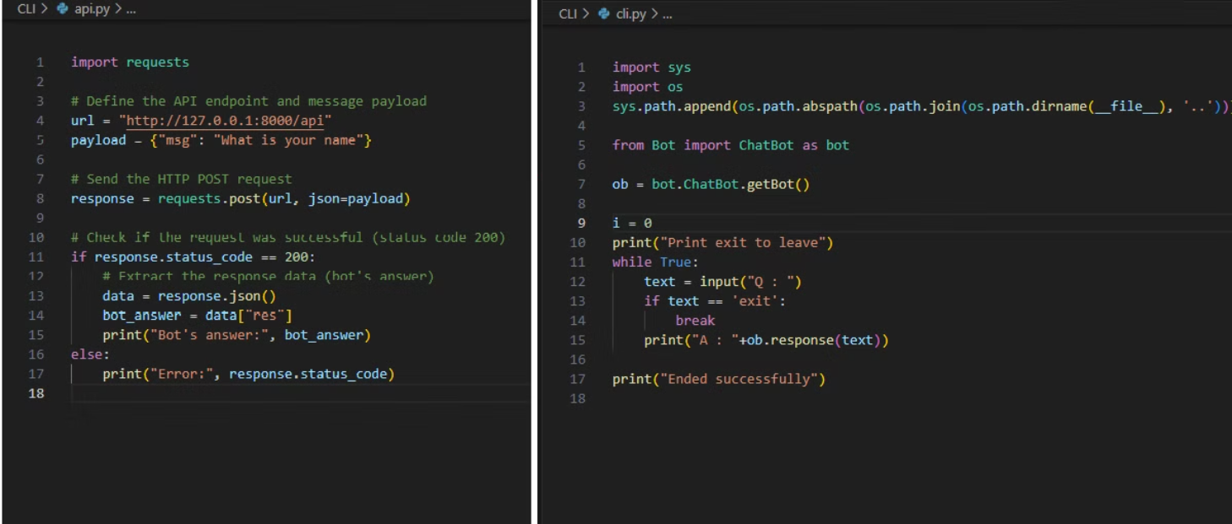
Implementation
api.py cli.py

Slide 12

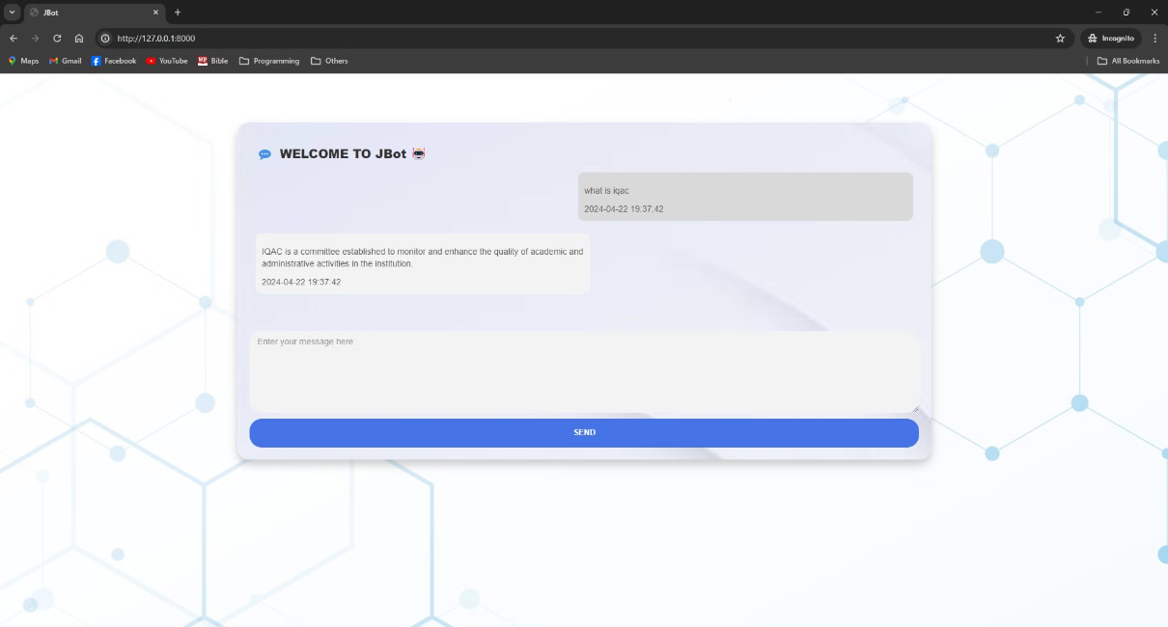
Results
Web Interface

Slide 13

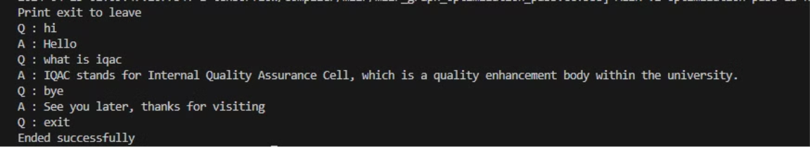
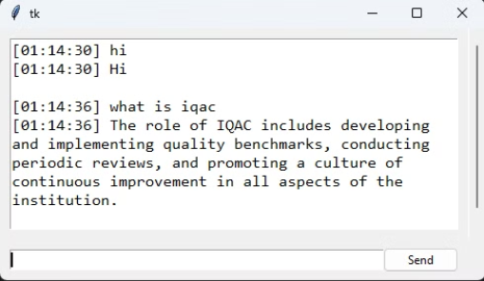
Results
Command Line Interface (CLI)
Application Programming Interface (API)
Graphical User Interface (GUI)

Slide 14


References
[1]
Mangotra, H., Dabas, V., Khetharpal, B., Verma, A., Singhal, S., & Mohapatra, A. K., "University Auto Reply FAQ Chatbot Using NLP and Neural Networks," Research Article, India, 9 May 2023.
[2]
Mikic Fonte, F. A., Llamas Nistal, M., Burguillo Rial, J. C., & Caeiro Rodríguez, M., "NLAST: A natural language assistant for students," Conference Paper, Department of Telematics Engineering, University of Vigo, Vigo, Spain, April 2017.
[3]
Chougule, A., Patole, N., Patil, S., & Tondare, P., "Chatbot: A Virtual Companion," Department of E&TC, SKNCOE, SPPU, Pune, 2023.

Slide 15




